Slide 1
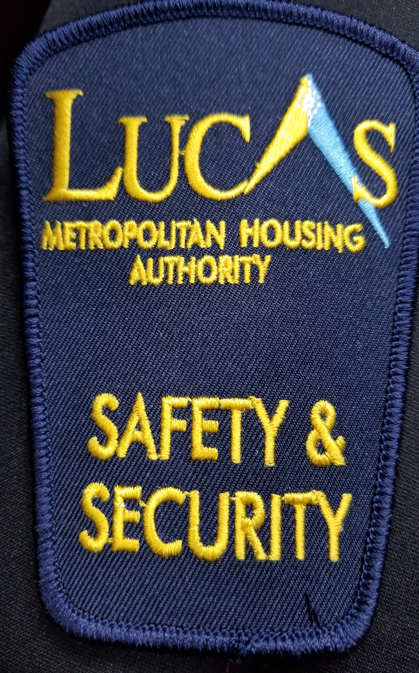

Public safety DEPARTMENT
Offices located at 201 Belmont Ave., Toledo, Ohio
STAFF-John McGuire, a recently retired Police Chief, Vice President of Public Safety – Develop standard operating procedures, selection and hiring, staff development and working toward accreditation for LMHA Police Department
Jim Gross, Field Operations Safety Coordinator - Manages operations in the field, supervises and trains mobile and static patrol officers, responds to calls for service and staff and resident concerns
Kathy Healy, Safety, Access & Communications Supervisor – Maintains controlled access system for resident properties, communicate with staff and residents regarding safety issues and access concerns, dispatches security personnel to calls for service
Six Mobile Patrol Officers perform Community Oriented Licensed Patrols – Directed Patrols, Safety Sweeps, Security Checks & Special Attentions – work in coordination with Lucas County Sheriff Deputies & Toledo Police Officers, including LMH static building security officers (currently a private company.)
CURRENTLY RECRUITING AND HIRING QUALIFIED OPOTA CERTIFIED OFFICERS

Slide 2
WHAT WE DO
PATROL SECTION – Provide basic patrol for all LMH facilities, attend and provide security for all special LMH and community functions, respond to any and all emergency situations involving LMH properties, residents and employees, monitor CCTV cameras.
STATIC SECTION - Community Policing, Crime Suppression and Resident interaction.
ADMINISTRATIVE SECTION - Complaint investigations, Special Attentions, Property/Logistics/Vehicles, Safety Training, Records Management/Information flow, Communications statistics, Access Security and Special Projects
FUN FACT: VP Public Safety, Field Operations Coordinator and Safety Access & Communications Supervisor have over 95 years experience in law enforcement.

Slide 3
Our MISSION
THE MISSION OF THE LUCAS METROPOLITAN HOUSING PUBLIC SAFETY DEPARTMENT IS TO BE A LEADER IN PROVIDING SAFE, SECURE, AFFORDABLE HOUSING FOR INDIVIDUALS AND FAMILIES OF LUCAS COUNTY.
THE GOAL OF LMH PUBLIC SAFETYIS TO PROTECT RESIDENTS, STAFF, AND PROPERTY, DECREASE THE FEAR OF CRIME, EMPOWER CITIZENS & RESIDENTS TO BECOME PART OF THE SOLUTION AND TEAM, AND TO PROVIDE PROFESSIONAL AUXILARY SERVICES IN SUPPORT OF LMH WHILE WORKING TOWARDS BECOMING A FULLY ACCREDITED LAW ENFORCEMENT AGENCY.
THE PRIMARY PURPOSE OF THE LMH PUBLIC SAFETY DEPARTMENT IS TO BUILD TRUST,COMMUNICATION AND RELATIONSHIPS WITH ITS RESIDENTS AND COMMUNITIES, WHILE PROVIDING A VISIBLE, UNIFORMED SECURITY PRESENCE FOR MATTERS PERTAINING TO PRESERVING AND PROTECTING LIFE AND PROPERTY ON LMH PREMISES.
THE PHILOSOPHY AND STANDARD UTILIZED & ODOPTED BY LMH PUBLIC SAFETY DEPARTMENT IS “COMMUNITY POLICING”. OUR ROLE IS TO FOSTER, LEAD, AND ENHANCE SAFETY & SECURITY THROUGH OPEN DIALOG, BUILDING TRUST & RELATIONSHIPS THROUGH COMMUNICATION, INTERACTION & MENTORING, AND COMMUNITY PARTNERSHIPS.

